Slide 1
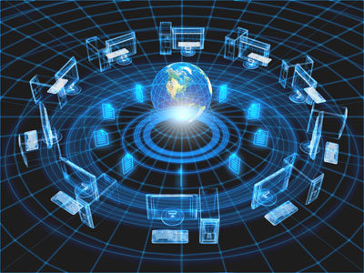
Introduction To Information Technology
Presented By:
Abdul Ghofir, M.Kom

Slide 2
Definition of Information Technology
Information technology is the technology that uses computing with high speed communication links to spread information from one place to another.
Computer is a very important component of information technology
The world has become “global village” due to advancement in IT.

Slide 3
What is a Computer?
An electronic device that is programmed to accept data, process data into useful information and store it for later use
Computer consists of hardware and software
Software is a set of instructions that tells a computer what to do
Hardware is the physical part of a computer E.g. keyboard , mouse etc
Relationship between hardware and software

Slide 4
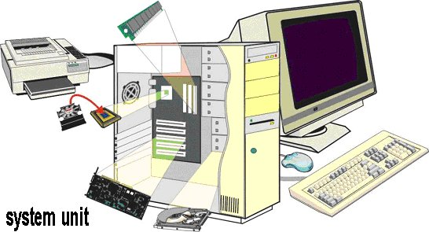

Slide 5
Few Basics
Computer
Hardware
Software
CPU
Memory
I/O
Etc.
Application
Software
System
Software

Slide 6
Types of Computers
Analog computers
Digital computers

Slide 7
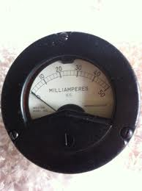
Analog Computers
An analog computer recognizes data as a continuous measurement of a physical property.
It has no state
Its output is usually displayed on a meter or graphs.
Examples are Analog clock, speed of a car, thermometer etc

Slide 8
Digital Computers
It works with numbers
They breaks all types of information into tiny units and use numbers to represent those pieces of information.
Everything is described in two states i.e. either ON (1) or OFF (0).
They are very fast and have big memory

Slide 9
History and Generations of computers
The six generations of computers are:
Mechanical era(1623-1900)
First generation electronic computers(1942-1955)
Second generation (1956-1962)
Third generation (1963-1972)
Forth generation (1972-1984)
Fifth generation (1984-1990)
Sixth generation (1990 - present)

Slide 10
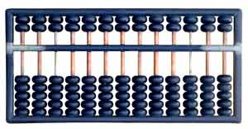
Mechanical Era
Abacus (3000 BC)
It was used to perform addition, subtraction, division and multiplication. It consists of wooden beads and calculation were performed by moving these beads properly.

Slide 11
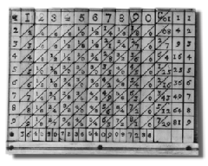
Mechanical Era
Napier’s bone (17th century)
It was a cupboard multiplication calculator
invented by john Napier.
It was used to perform difficult multiplication operations to simple addition of entries in a table

Slide 12
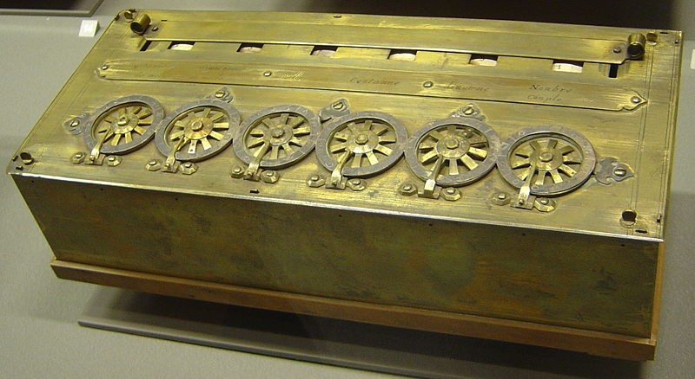
Mechanical Era
Pascaline (17th century)
It was invented by Blaise Pascal.
It was first mechanical adding machine
It had a series of wheels with teeth which could be turned using hands.

Slide 13
Mechanical Era
Difference Engine and Analytical Engine(1823 and 1833)
It was designed by Charles Babbage who was English mathematician, engineer, philosopher and inventor.
He originated the concept of the programmable computer.
A general purpose computer controlled by a list of instructions

Slide 14
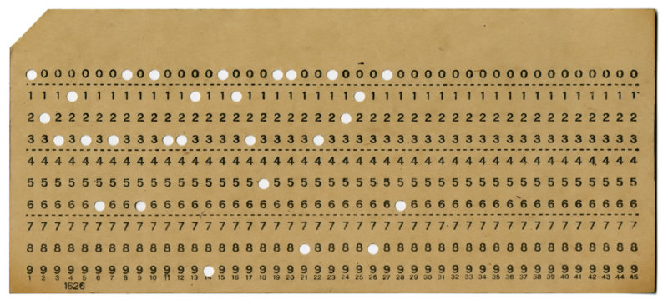
Mechanical Era
Punched cards (1890)
It’s able to read information that which have been punched into the cards automatically

Slide 15
First generation Electronic computers
First generation computers were used during 1942-1955 .
It was based on Vacuum Tube which was a glass (tube) that controlled and amplified the electronic signals

Slide 16
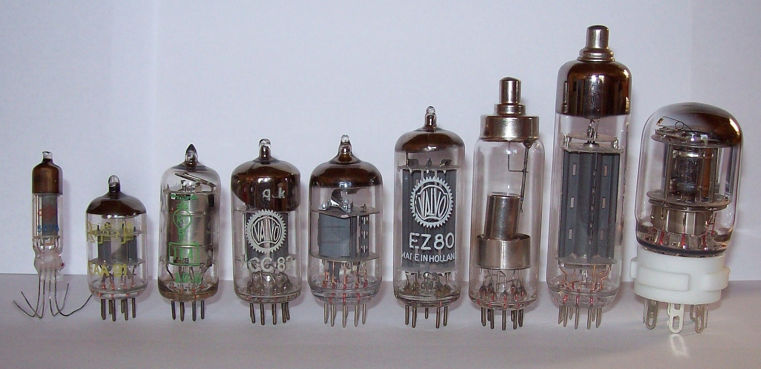
First generation Electronic computers
Vacum tube

Slide 17
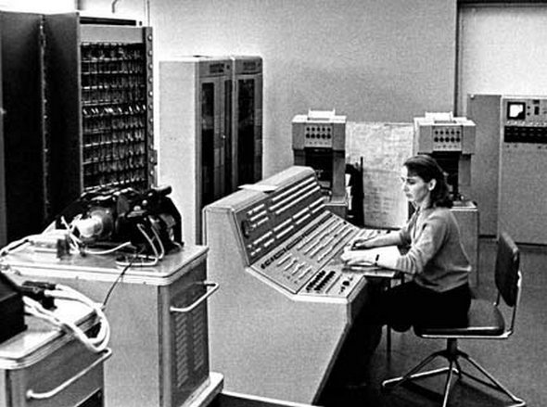
First generation Electronic computers

Slide 18
First generation Electronic computers
Consume more power with limited performance
High cost
Uses assembly language – to prepare programs. These were translated into machine level language for execution.

Slide 19
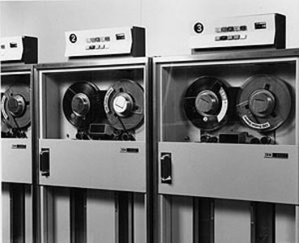
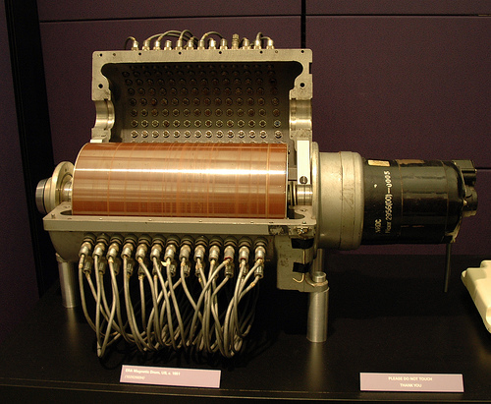
First generation Electronic computers
Punched cards and paper tape were invented to feed programs and data and to get results.
Magnetic tape / magnetic drum were used as secondary memory

Slide 20
First generation Electronic computers
Mainly used for scientific computations.
Examples are: UNIVAC, Havard Mark 1, ENIAC etc

Slide 21
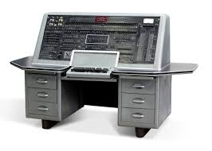
First generation Electronic computers
Univac

Slide 22
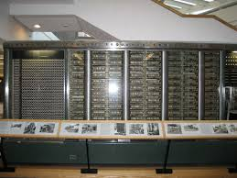
First generation Electronic computers
Harvard Mark 1

Slide 23
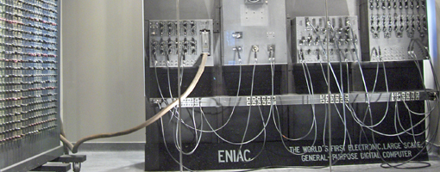
First generation Electronic computers
Eniac

Slide 24
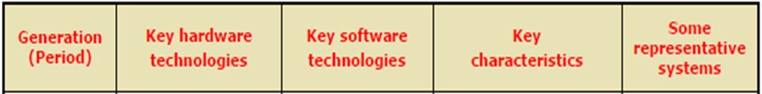
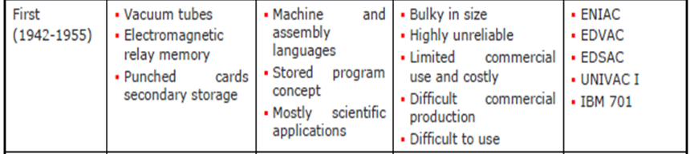
First generation Electronic computers

Slide 25
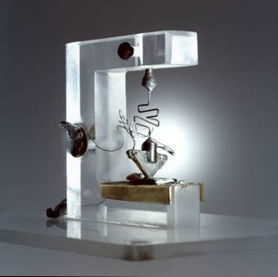
Second Generation (1955-1964)
Bell Lab invented the transistor – function like
vacuum tubes but smaller, lower power consumption, more reliable.
Transistor is a small device that transfer electronic signals across a resister
Lower cost
Magnetic core memories were used as main memory which is a random-access nonvolatile memory
Magnetic tapes and magnetic disks were used as secondary memory
Hardware for floating point arithmetic operations was developed.

Slide 26
Second Generation (1955-1964)
Index registers were introduced which increased flexibility of programming.
High level languages such as FORTRAN, COBOL etc were used - Compilers were developed to translate the high-level program into corresponding assembly language program which was then translated into machine language.
Separate input-output processors were developed that could operate in parallel with CPU.
Punched cards continued during this period also.
Examples are: TRADIC, IBM 704, LARC etc

Slide 27
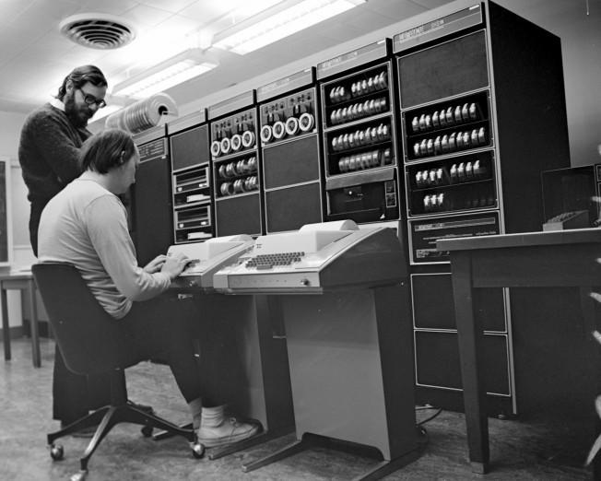
Second Generation (1955-1964)
Tradic

Slide 28
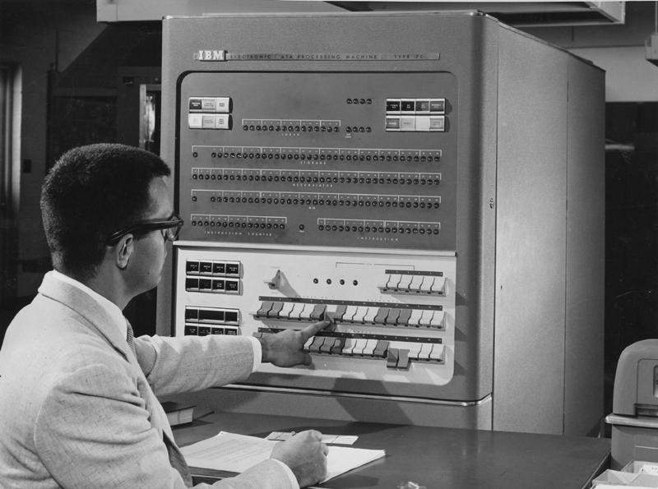
Second Generation (1955-1964)
IBM 704

Slide 29
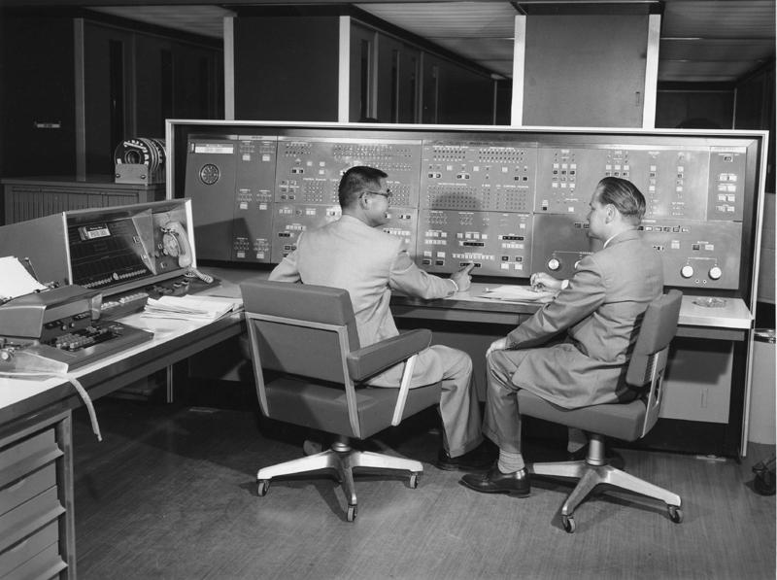
Second Generation (1955-1964)
LARC

Slide 30
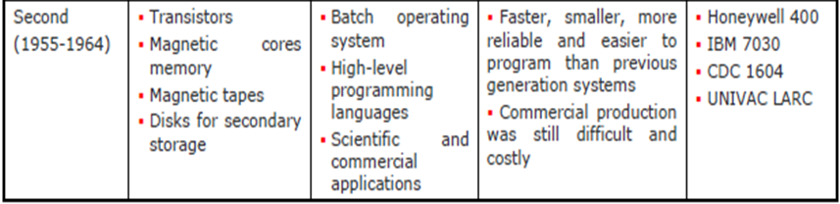
Second Generation (1955-1964)

Slide 31
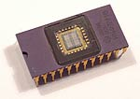
Third Generation (1963-1971)
Jack Kilby developed Integrated Circuit (IC)
An IC combined several electronic computers
on a small silicon chip
IBM introduced
System/360 – a highly configurable,
highly backward compatible,
mainframe computer system.
Small Scale Integration and Medium Scale Integration technology were implemented in CPU, I/O processors etc.
Smaller & better performance
Comparatively lesser cost
Faster processors

Slide 32
Third Generation (1963-1971)
In the beginning magnetic core memories were used. Later they were replaced by semiconductor memories (RAM & ROM)
Introduced microprogramming
Microprogramming, parallel processing (pipelining, multiprocessor system etc), multiprogramming, multi-user system (time shared system) etc were introduced.
Operating system software were introduced
Cache and virtual memories were introduced

Slide 33
Third Generation (1963-1971)
High level languages were standardized by ANSI e.g.. ANSI FORTRAN, ANSI COBOL etc
Database management, multi-user application, online systems like closed loop process control, airline reservation, interactive query systems, automatic industrial control etc emerged during this period.
Examples are: INTEL 4004, IBM SYSTEM/360 etc

Slide 34
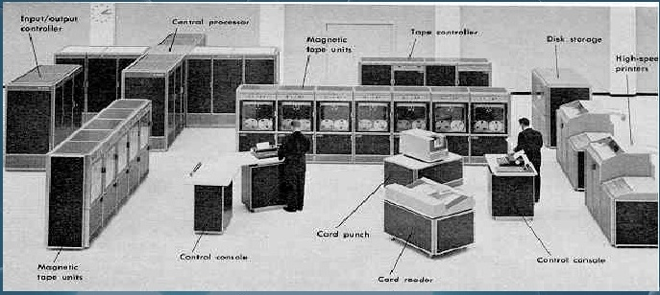
Third Generation (1963-1971)
Intel 4004

Slide 35
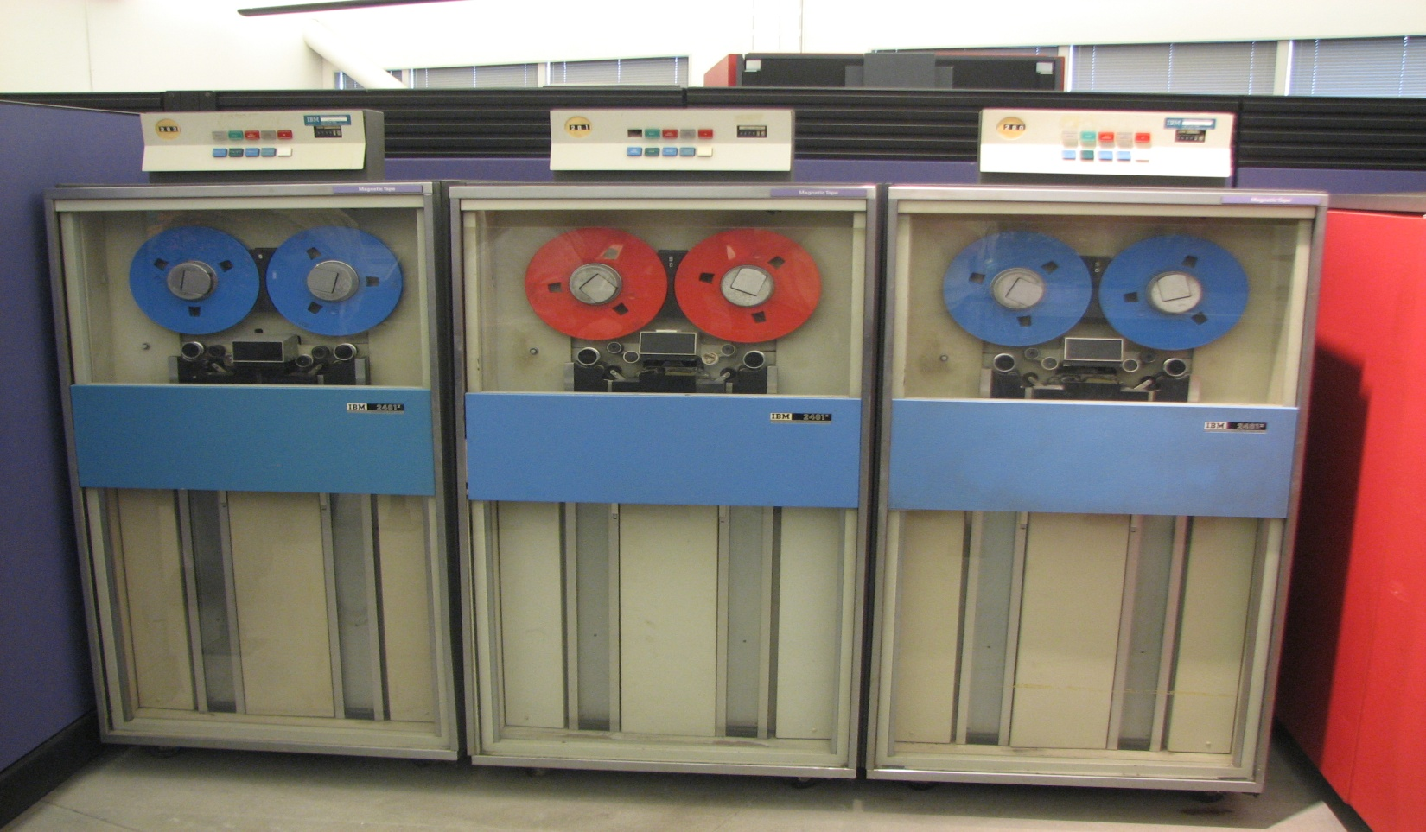
Third Generation (1963-1971)
IBM system 360

Slide 36
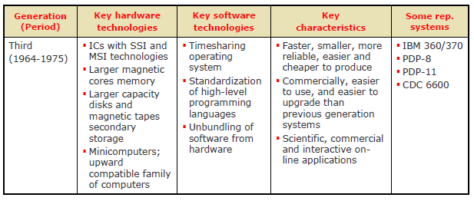
Third Generation (1963-1971)

Slide 37
Forth generation (1972-1984)
Microprocessors were introduced as CPU– Complete processors and large section of main memory could be implemented in a single chip
CRT screen, laser & ink jet printers, scanners etc were developed.
Semiconductor memory chips were used as the main memory.
Secondary memory was composed of hard disks – Floppy disks & magnetic tapes were used for backup memory

Slide 38
Forth generation (1972-1984)
LAN and WANS were developed (where desktop work stations interconnected)
Introduced C language and Unix OS
Introduced Graphical User Interface
Less power consumption
High performance, lower cost and very compact
Much increase in the speed of operation
Examples are Apple Macintosh and IBM PC

Slide 39
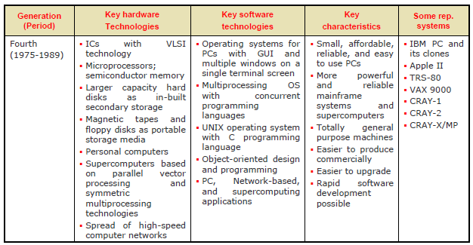
Forth generation (1972-1984)

Slide 40
Fifth Generation (1983-1990)
Computers based on artificial intelligence are available
Computers use extensive parallel processing, multiple pipelines, multiple processors etc
Massive parallel machines and extensively distributed system connected by communication networks fall in this category.
Introduced ULSI (Ultra Large Scale Integration) technology – Intel’s Pentium 4 microprocessor contains 55 million transistors millions of components on a single IC chip.
Superscalar processors, Vector processors, SIMD processors, 32 bit micro controllers and embedded processors, Digital Signal Processors (DSP) etc have been developed.
Memory chips up to 1 GB, hard disk drives up to 180 GB and optical disks up to 27 GB are available (still the capacity is increasing)
Object oriented language like JAVA suitable for internet programming has been developed.

Slide 41
Fifth Generation (1983-1990)
Portable note book computers introduced
Storage technology advanced – large main memory and disk storage available
Introduced World Wide Web. (and other existing applications like e-mail, e Commerce, Virtual libraries/Classrooms, multimedia applications etc.)
New operating systems developed – Windows 95/98/XP/…, LINUX, etc.

Slide 42
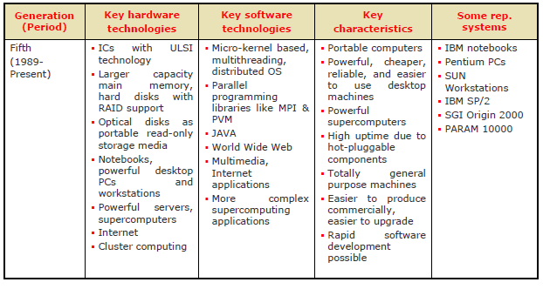
Fifth Generation (1983-1990)

Slide 43
Sixth Generation Computers(1990-till date)
Some inventions of the time are WWW, HTML, HTTP, Web TV, java, DVD, iPod, Youtube etc
Examples are: iMac , Sun ultra workstation etc

Slide 44
Computers Systems and its Components
Input Devices
Output devices
System Unit
Storage devices
Communication devices

Slide 45
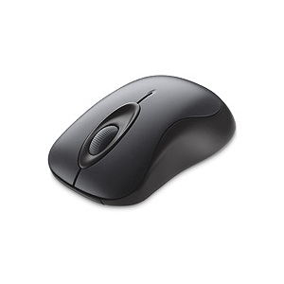
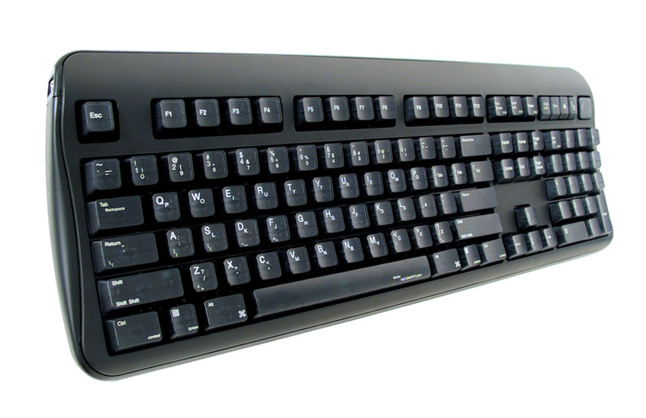
Input devices
The devices that are used to enter data and instructions into the computers
Most commonly used input devices are Keyboard and Mouse

Slide 46
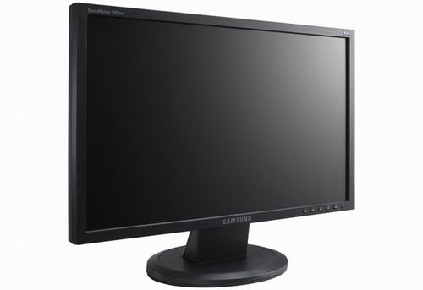
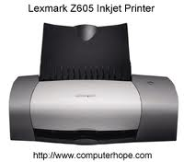
Output Devices
Output devices are used to display processed data to the user
Most commonly used output devices are Monitor, Printer and speakers
Hard Copy is paper copy – tangible
Soft copy is intangible

Slide 47
System Unit
Its a box that contains different components of a computer system.
All electronic components in the system unit are connected to motherboard
Important components of system units are:
Central processing Unit(Processor)
Memory

Slide 48
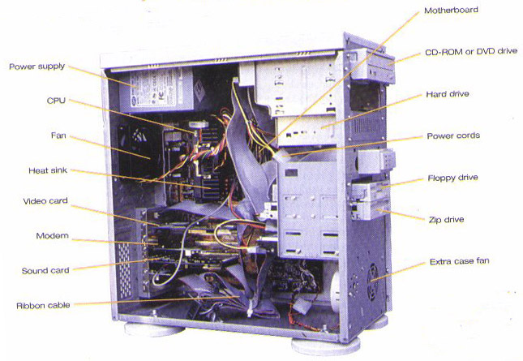
System Unit

Slide 49
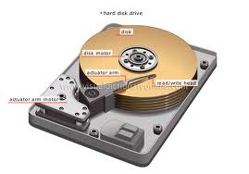
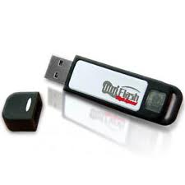
Storage Devices
These are used to store data permanently even when the computer is turned off
It is non volatile memory
Examples:
Floppy Disk, Hard disk, CD ROM

Slide 50
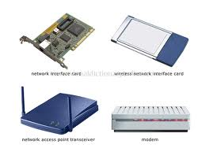
Communication devices
A communication device is a hardware component that enables a computer to send and receive data, instructions and information to and from one or more computers.
A widely used communication device is Modem
Wired media
Wireless media

Slide 51
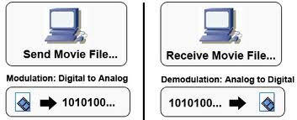
Modulation and Demodulation
Modulation
Conversion from Digital signals to Analog signals
Demodulation
Conversion from Analog signals to Digital signals

Slide 52
Computers in society
Home
Education
Small business
Industry
Government
Health care
Banking
Communication
Police Department
Retail

Slide 53
Information Processing Cycle
Data
A collection of raw facts and figures is called data. It may consist of numbers, characters, symbols or pictures etc
Information
Processed data is called information. It is more meaningful than data.

Slide 54
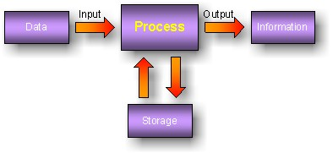
Information Processing Cycle
Data is collected and given to the computer for processing
Computer process data to the required information
The information is given to the user as output
Information is stored in the computer for further use

Slide 55
Advantages of computers
Reliability
Speed
Consistency
Storage
Communications

Slide 56
Disadvantages of computers
Violation of Piracy
Public Safety
Impact on Labor Force
Health Risks
Impact on Environment

